Slide 1
Classifying Organisms Mnemonic Device
Directions and Example

Slide 2
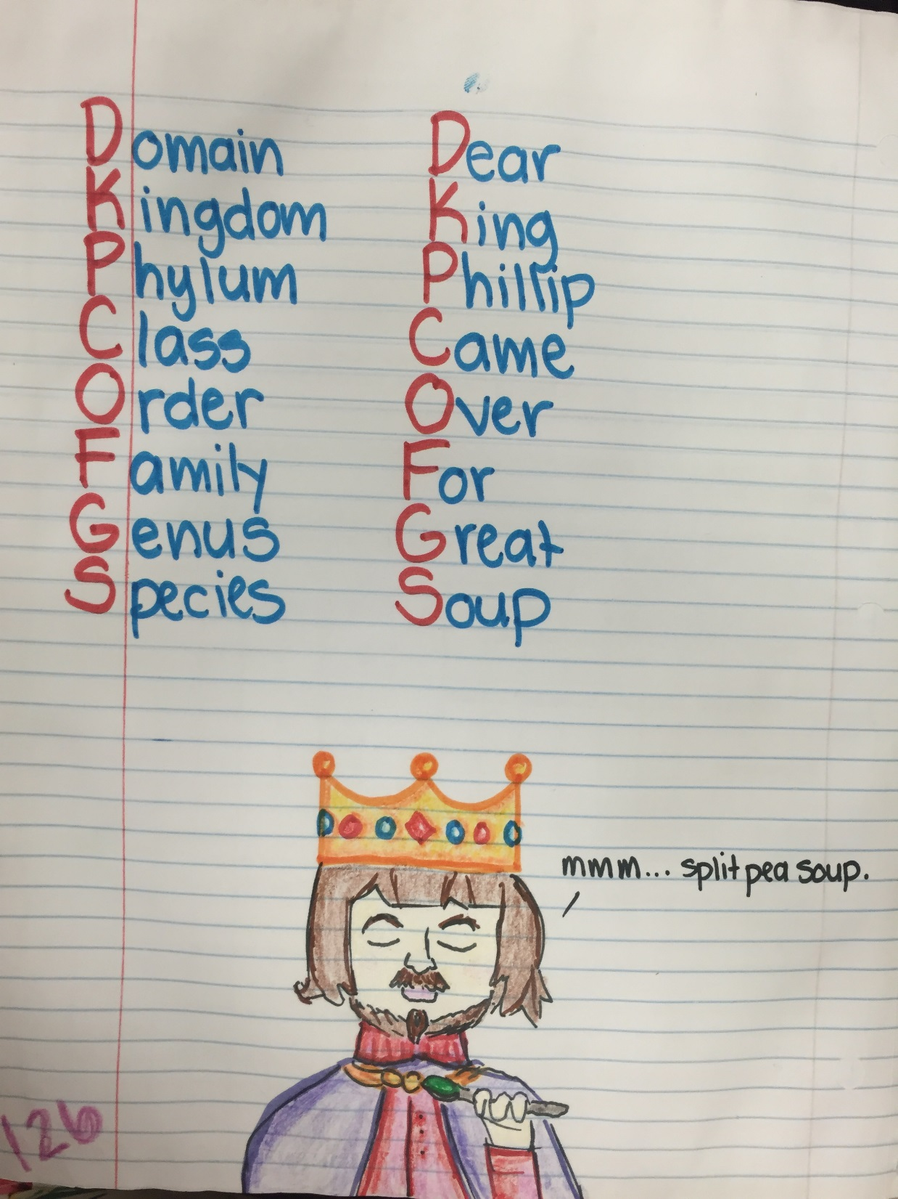
2
Mnemonic
Device
Directions
Create your own mnemonic device (memory trick) using the first letter of each word to create a phrase.
1
Copy the levels of organization from largest to smallest.
3
Illustrate your mnemonic device in a picture.

